Slide 1
Clean Desk Policy
Contains
Purpose
Good Business Practice
How to implement policies
Some Practices
By
Ibrahim Khandker
Sandesh Hyoju.

Slide 2
Definition
A clean desk policy (CDP) is a corporate directive that specifies how employees should leave their working space when they leave the office.
Papers
Workstation
Furniture
Other small devices

Slide 3
Purpose
Keep offices free of clutter and to present outsiders with an impression of professionalism and competence.
Avoiding unwanted access of confidential matter to others.
Increasing security.
Protection from loss.

Slide 4
Info
According to an IDC report, a typical employee in a organization spends 2.5 hours a day searching for information.
Assuming the knowledge workers in organization earn $80,000 a year, a 1000 person organization loses approximately $2.5 million dollars a year from the inability to locate and retrieve information.

Slide 5
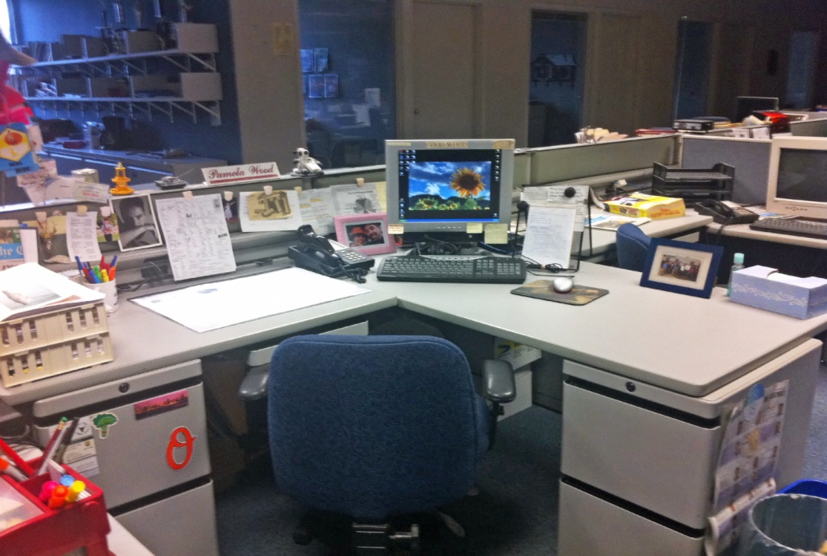
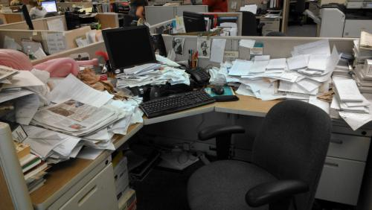
Which one do you prefer!

Slide 6
Good Business Practices
If you don’t need it, don’t collect it
If you need it only once, don’t save it
If you don’t need to save it, dispose of it properly
If you have to save it, store it securely
If you have to transmit it, transmit securely
Don’t give out information without knowing the recipient/positive confirmation

Slide 7
How to implement policy?
Informing employees necessity of “Clean desk Policy”.
Weakness and vulnerability analysis.
Discuss about employee’s opinion.
Real life example.
Arranging possible training period.
Imposing rules.

Slide 8
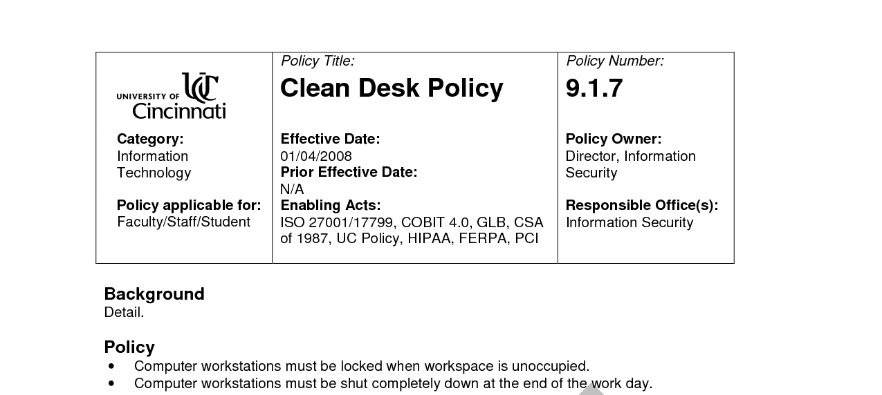
Put it in Writing
A clear desk policy should be in writing and communicated to all employees, especially during introductory and refresher training.

Slide 9
Add a Reminder to Email Signatures
We have probably seen it below many email signatures: Please consider the environment before printing this email. If our organization uses standardized email signatures, consider having this reminder added to the bottom.

Slide 10
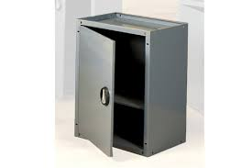
Lockable Storage
We can’t implement a clear desk policy if we have no where for employees to put their documents. Consider purchasing small, lockable storage boxes for employees that fit under their desk.

Slide 11
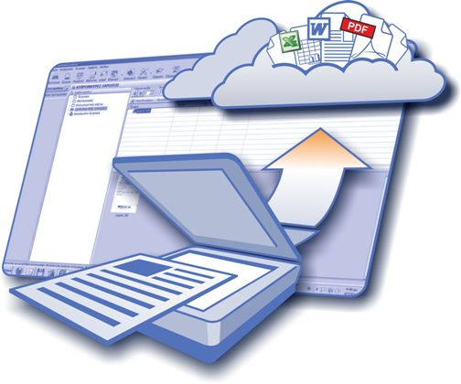
Encourage Electronic Documents
Have employees work with electronic documents whenever possible. Without the need to print and work with physical papers, our employees will always have a clear desk whenever they log out of their computers.

Slide 12
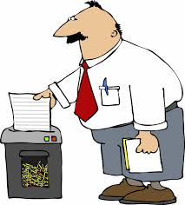
Get Rid of Documents Securely
Use a secure shredding service to ensure all documents are disposed of securely.

Slide 13
Perform Routine Backups
If we discourage employees from using physical documents, make sure our organization has a dependable backup routine in place. Employees need to know that their documents will be safe in the event of a power loss or hard-drive crash.

Slide 14
Random Checks
Have our privacy officer conduct random weekly checks, possibly at the end of a work day. All papers, notes, post-its, or any other documents containing sensitive information should be shredded immediately.
Removable media, such as CDs, floppy disks, or memory sticks should be confiscated.

Slide 15
Upper Management Support
A clear desk policy needs to be taken seriously especially with all levels of management. If our employees see that upper management does not have to abide by the policy, they will soon lose faith.

